Slide 1
AGILE MANAGEMENT

Slide 2
WHAT IS AGILE METHODOLOGY ?
AGILE methodology is a practice that promotes continuous iteration of development and testing throughout the software development lifecycle of the project. Both development and testing activities are concurrent unlike the Waterfall model

Slide 3
Agile Methodology
Agile method proposes incremental and iterative approach to software design.
The agile process is broken into individual models that designers work on.
The customer has early and frequent opportunities to look at the product and make decision and changes to the project. Small projects can be implemented very quickly.
Error can be fixed in the middle of the project.
Development process is iterative, and the project is executed in short (2-4) weeks iterations. Planning is very less.
Every iteration has its own testing phase. It allows implementing regression testing every time new functions or logic are released.
In agile testing when an iteration end, shippable features of the product is delivered to the customer. New features are usable right after shipment. It is useful when you have good contact with customers.

Slide 4
What is Scrum Master Profile ?
A scrum master is the facilitator for an agile development team. Scrum is a methodology that allows a team to self-organize and make changes quickly, in accordance with agile principles. The scrum master manages the process for how information is exchanged.

Slide 5
Scrum master profile
Facilitate his team for better creativity and tries to improve the efficiency of the development team.
Responsible for managing the scrum process with the coordination of scrum team in Agile methodology.
Responsible to remove the impediments for the scrum team.
Arranged daily stand-up meetings, facilitate meetings, schedule meetings, demo and decision-making processes in order to ensure quick inspection and proper use of adaptation process.
Helps product owner to make the product backlogs in good shape and make them ready for the next sprint.
Responsible to Conduct retrospective meetings.
Organizes and facilitates the sprint planning meeting.
Acts as safeguard for his team.

Slide 6

Role of Scrum Master in Agile
INTERNAL ROLES
EXTERNAL ROLES
Clearing obstacles
Establishing an environment where the team can be effective
Addressing team dynamics
monitoring the scrum processes and scrum meetings
Ensuring a good relationship between the team and product owner as well as others outside the team
Protecting the team from outside interruptions and distractions.
6

Slide 7
User Stories
Short, simple descriptions of a feature told from the perspective of the person who desires the new capability, usually a user or customer of the system.
User stories are part of an agile approach that helps shift the focus from writing about requirements to talking about them.

Slide 8
Why user story is so good?
Understood equally well by everyone
Useful for iteration planning
Great for iterative development
Encourage deferring of details
Include varying levels of detail
Support opportunistic design
Emphasize verbal communication

Slide 9
Sprint Planning
It’s a scrum framework where the team determines the product backlog items to work on during that sprint and discusses their initial plan for completing those product backlog items.
This collaborative effort involves a Scrum Master, a Product Owner, and the Entire Agile Management Team.

Slide 10
Sprint Planning Steps
Confirm any currently known issues and concerns and record as appropriate
Review the definition of DONE and make any appropriate updates based on technology, skill, or team member changes since the last sprint
Present proposed product backlog items to consider for the sprint backlog
Determine the needs, sign up for work, and estimate the work owned
Product Owner answers clarifying questions and elaborates acceptance criteria
Confirm any new issues and concerns raised during meeting and record
Confirm any assumptions or dependencies discovered during planning and record
Scrum Master calls for a group consensus on the plan
Team and Product Owner signal if this is the best plan they can make given what they know right now

Slide 11
Retrospection in Agile Management
An opportunity for the Scrum Team to inspect itself and create a plan for improvements to be enacted during the next Sprint.
Meetings intended to reflect on the most recent sprint/project/milestone and celebrate team wins.

Slide 12
Agile Retrospection Steps
Set Stage – Setting up of the meeting by the facilitator, sending a meeting invitation to all the required team members.
Gather Data – Gathering ideas, opinions, concerns that the team members might have.
Generate Insights – Identifying meaningful analytic trends and creating patterns to resolve them.
Create Actions – Assigning actions to an accountable person(s) who will be responsible to resolve it by the decided due date.
Wrap Up – Thank the team for their time and for their participation.

Slide 13
Burndown Charts in Agile
The burndown chart that shows how quickly you and your team are burning through your customer's user stories.
It shows the total effort against the amount of work we deliver each iteration.

Slide 14
Burndown charts in Agile Management
A large graph relating the quantity of work remaining (on the vertical axis) and the time elapsed since the start of the project (on the horizontal, showing future as well as past).
Two variants exist, depending on whether the amount graphed is for the work remaining in the iteration ("sprint burndown") or more commonly the entire project ("product burndown").
This practice results in up-to-date project status being not only visible, but in fact shoved into the faces of everyone involved: as a result it encourages the team to confront any difficulties sooner and more decisively.

Slide 15
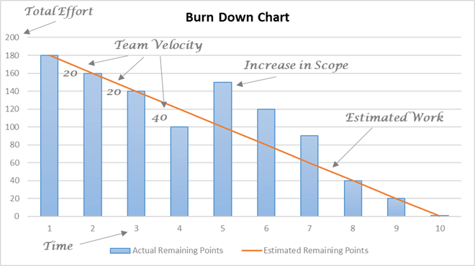
They are useful because:
Make the reality of the project clear.
Show the impact of decisions.
Warn you early if things aren't going according to plan.
Get rid of all the wishful thinking around dates.

Slide 16
Planning Poker
Also called Scrum poker, planning poker is a consensus-based, agile planning technique for estimating effort or relative size of development goals or product backlogs.
It brings together multiple expert opinions for the agile estimation of a project.

Slide 17
Planning Poker in Agile Management
To start a poker planning session, the team meets in presence of the customer or Product Owner.
Around the table, each team member holds a set of playing cards, bearing numerical values appropriate for points estimation of a user story.
The product owner briefly states the intent and value of an agile user story. Each member of the development team silently picks an estimate and readies the corresponding card, face down. When everyone has taken their pick, the cards are turned face up and the estimates are read aloud.
This type of agile planning includes everyone: programmers, testers, database engineers, analysts, user interaction designers, and all other personnel involved in the project.

Slide 18
What is the daily standup
The scrum meeting, or the daily stand-up, is the 15 minute meeting that makes product development teams more productive and efficient.
Ideally, a daily scrum meeting is held in the morning, as it helps set the context for the coming day's work.

Slide 19
Daily Standup Meetings
Scrum affords special status to those who are committed, and many teams enforce a rule in which only those who are committed are allowed to talk during the daily scrum meeting.
The daily scrum meeting is not used as a problem-solving or issue resolution meeting. Issues that are raised are taken offline and usually dealt with by the relevant subgroup immediately after the meeting.
By focusing on what each person accomplished yesterday and will accomplish today, the team gains an excellent understanding of what work has been done and what work remains. The daily scrum meeting is not a status update meeting in which a boss is collecting information about who is behind schedule. Rather, it is a meeting in which team members make commitments to each other.

Slide 20
Scrum board
In Scrum the task board is a visual display of the progress of the Scrum team during a sprint.
It presents a snapshot of the current sprint backlog allowing everyone to see which tasks remain to be started, which are in progress and which are done.
Usually this is done with index cards or post-it notes.

Slide 21
Scrum board example
The task board is usually divided into columns. These are:
Stories – this column contains a list of all the user stories in the current sprint backlog
Not started – this column contains sub tasks of the stories that work has not started on
In progress – all the tasks on which work has already begun
Done – all the tasks which have been completed

Slide 22
What is Kanban?
Kanban is a set of tools you can use to get better at doing agile.
It is a means to design, manage the creation of product and improve flow systems for knowledge work, with an emphasis on continual delivery while not overburdening the development team.

Slide 23
Kanban
The method allows organizations to start with their existing workflow and drive evolutionary change. They can do this by visualizing their flow of work, limit work in progress (WIP) and stop starting and start finishing.
Kanban promotes continuous collaboration and encourages active, ongoing learning and improving by defining the best possible team workflow.

Slide 24
What is Jira?
Jira Software is an agile project management tool that supports any agile methodology, be it scrum, kanban, or your own unique flavor.
From agileboards to reports, you can plan, track, and manage all your agile software development projects from a single tool.

Slide 25
Product holder owner
The Product Owner role is the most important role for ensuring an Agile project successfully delivers value to the business.
The Scrum Guide describes the Product Owner role as being: "Responsible for maximizing the value of the product resulting from work of the Development Team."

Slide 26
Product holder owner
Creates and MAINTAINS the Product Backlog
Prioritizes and sequences the Backlog according to business value or ROI
Assists with the elaboration of Epics, Themes and Features into user stories that are granular enough to be achieved in a single sprint.
Conveys the Vision and Goals at the beginning of every Release and Sprint
Represents the customer, interfaces and engages the customer
Participates in the daily Scrums, Sprint Planning Meetings and Sprint Reviews and Retrospectives.
Inspects the product progress at the end of every Sprint and has complete authority to accept or reject work done.
Can change the course of the project at the end of every Sprint
Communicates status externally
Terminates a Sprint if it is determined that a drastic change in direction is required

Slide 27
Velocity in Agile
Velocity is an extremely simple, powerful method for accurately measuring the rate at which scrum development teams consistently deliver business value.
It is a measure of the amount of work a team can tackle during a single Sprint and is the key metric in Scrum.
To calculate velocity of your agile team, simply add up the estimates of the features, user stories, requirements or backlog items successfully delivered in an iteration.

Slide 28
What is Sprint Backlog?
The sprint backlog is a list of tasks identified by the Scrum team to be completed during the Scrum sprint, plus a plan for delivering the product Increment and realizing the Sprint Goal.
During the sprint planning meeting, the team selects some number of product backlog items, usually in the form of user stories, and identifies the tasks necessary to complete each user story.

Slide 29
Sprint Backlog
The Sprint Backlog makes visible all the work that the Development Team identifies as necessary to meet the Sprint Goal.
To ensure continuous improvement, it includes at least one high priority process improvement identified in the previous Retrospective meeting.
The Sprint Backlog is a plan with enough detail that changes in progress can be understood in the Daily Scrum.
The Development Team modifies the Sprint Backlog throughout the Sprint. Only the Development Team can change its Sprint Backlog during a Sprint.
The Sprint Backlog is a highly visible, real-time picture of the work that the Development Team plans to accomplish during the Sprint, and it belongs solely to the Development Team.

Slide 30
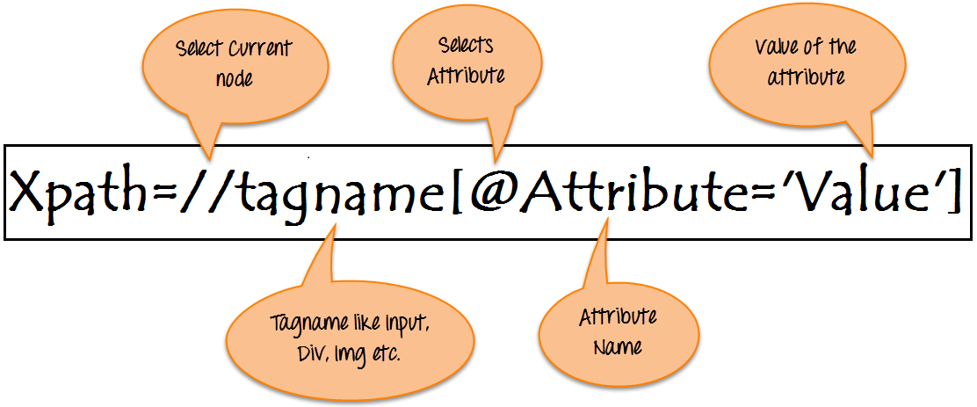
Xpath
XPath is defined as XML path. It is a syntax or language for finding any element on the web page using XML path expression. XPath is used to find the location of any element on a webpage using HTML DOM structure.
If the elements are not found by the general locators like id, class, name, etc. then XPath is used to find an element on the web page .

Slide 31
Types of X Path
Absolute XPath
Relative XPath

Slide 32
Relative Xpath:
The path starts from the middle of the HTML DOM structure. It starts with the double forward slash (//), which means it can search the element anywhere at the webpage.
You can start from the middle of the HTML DOM structure and no need to write long xpath.

Slide 33
Absolute Xpath:
It is the direct way to find the element, but the disadvantage of the absolute XPath is that if there are any changes made in the path of the element then that XPath gets failed.
The key characteristic of XPath is that it begins with the single forward slash(/) ,which means you can select the element from the root node.

Slide 34
Thank You

